Slide 1

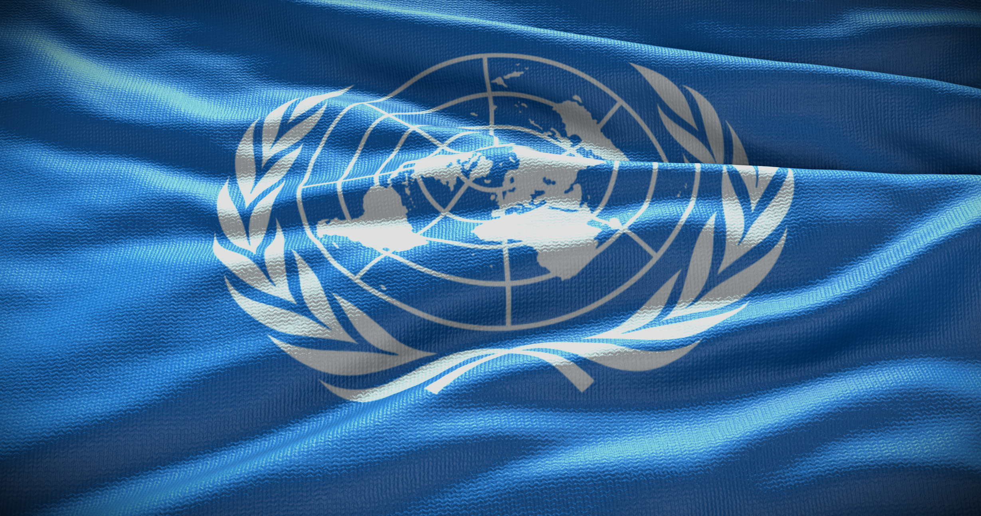





1945 to Present
Chapter 35
THE UNITED NATIONS
the united nations
Strand Two & Three: The History of the World
@MsDoorley

Slide 2

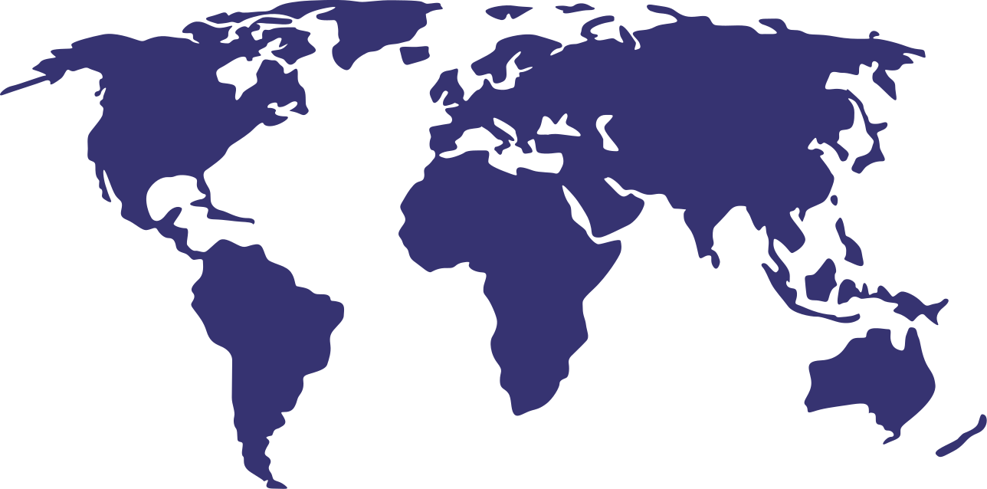

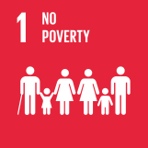
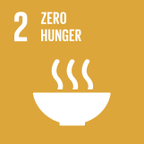

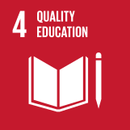
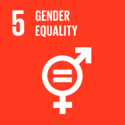
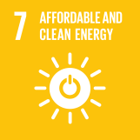
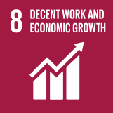
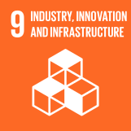
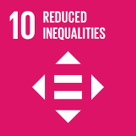
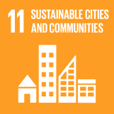
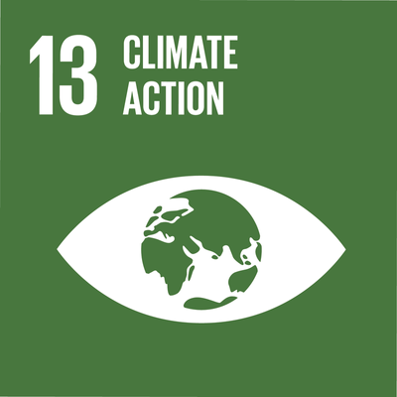
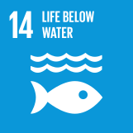
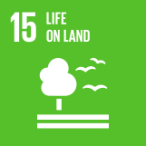
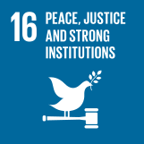
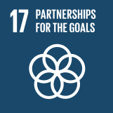

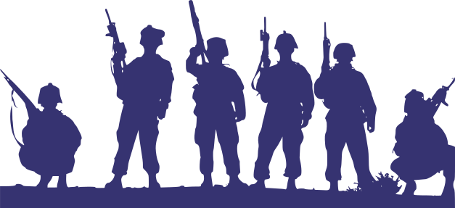
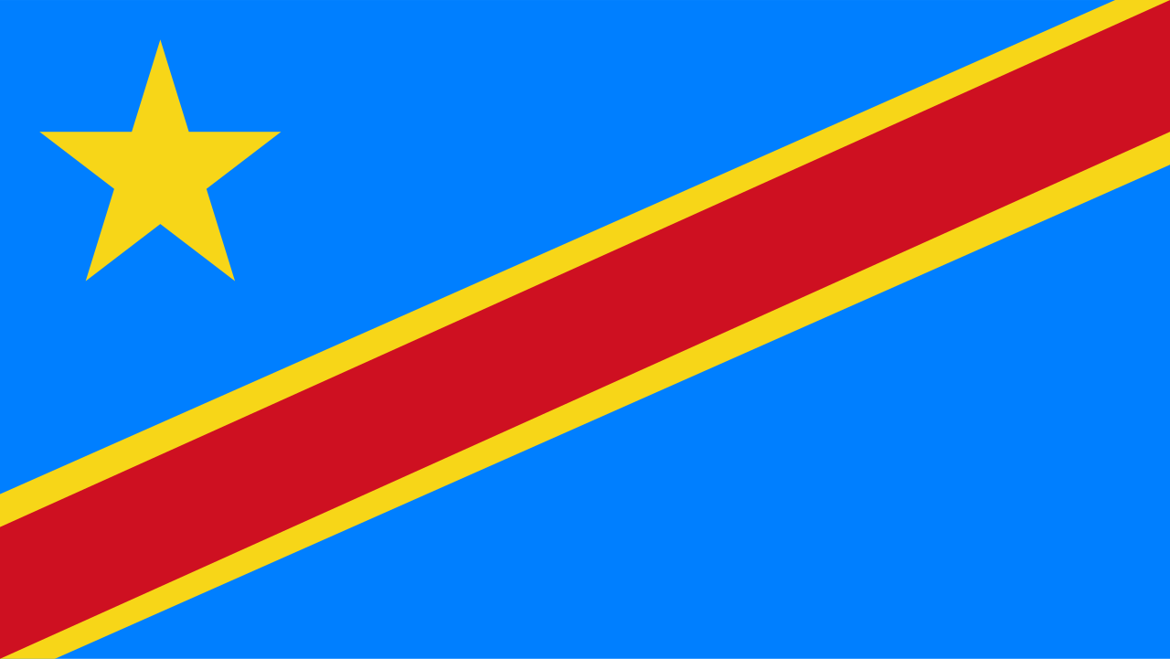
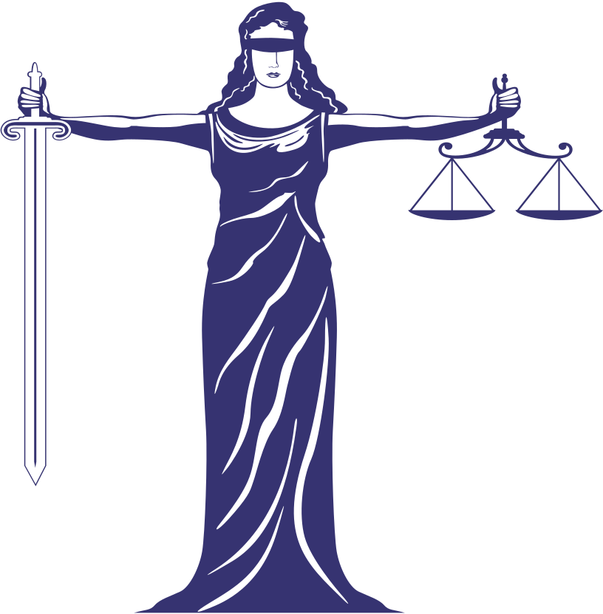




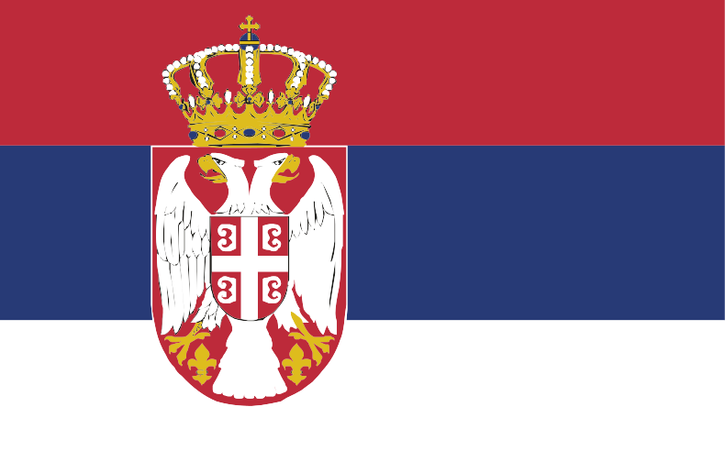
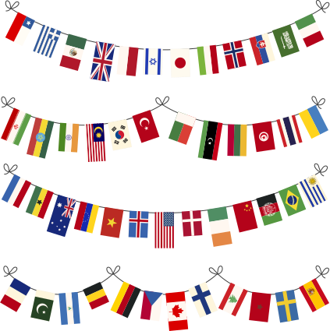
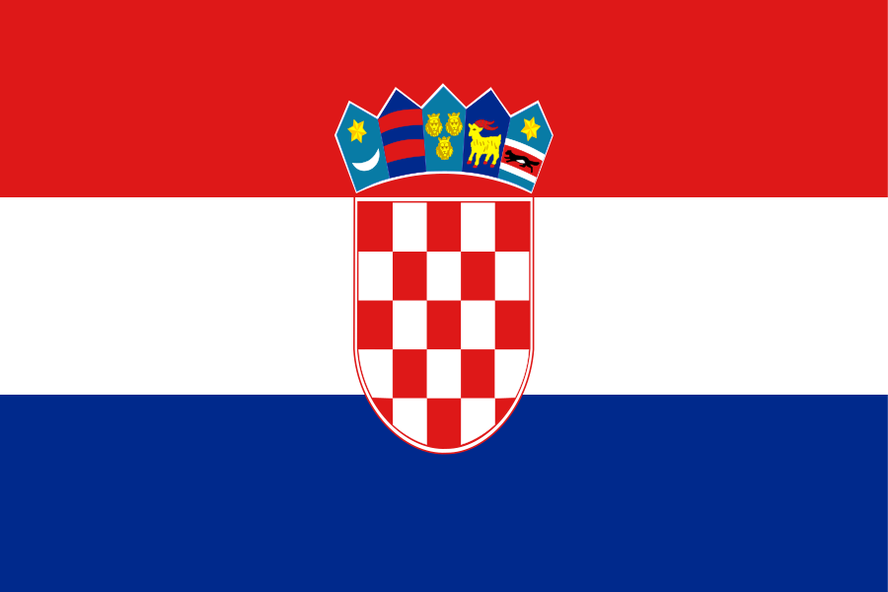








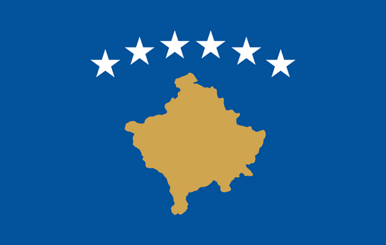
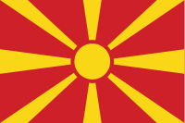
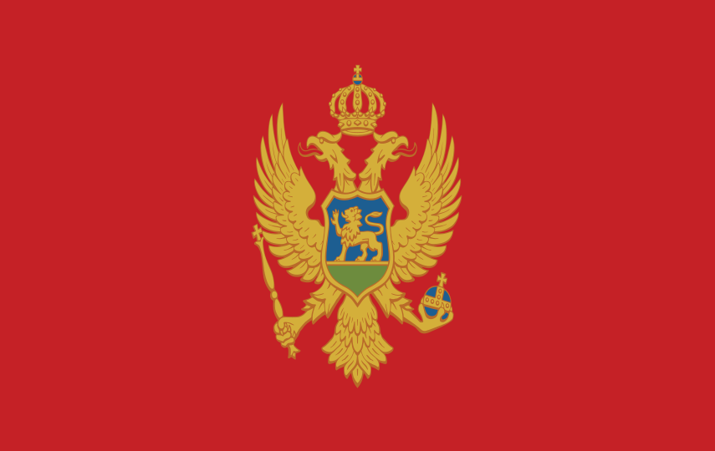



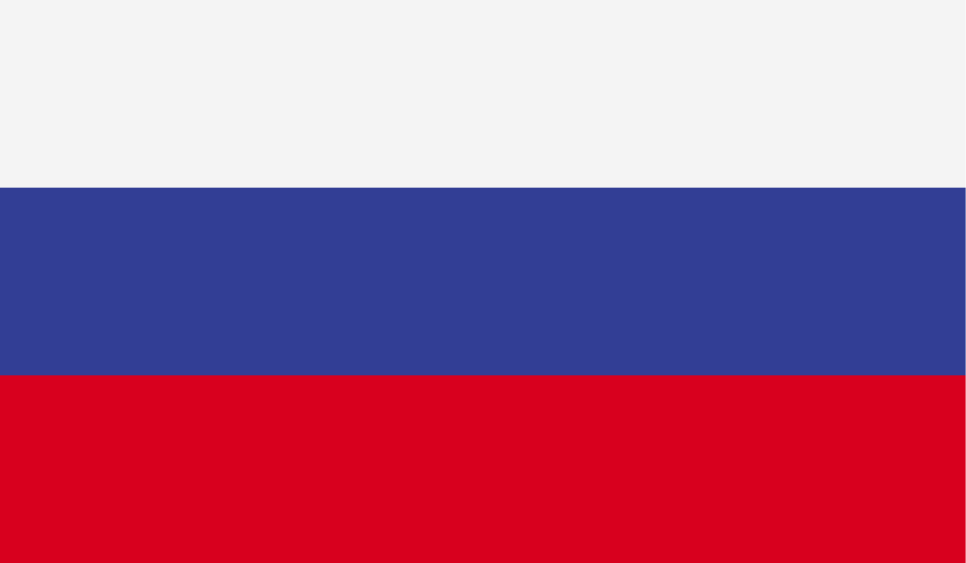
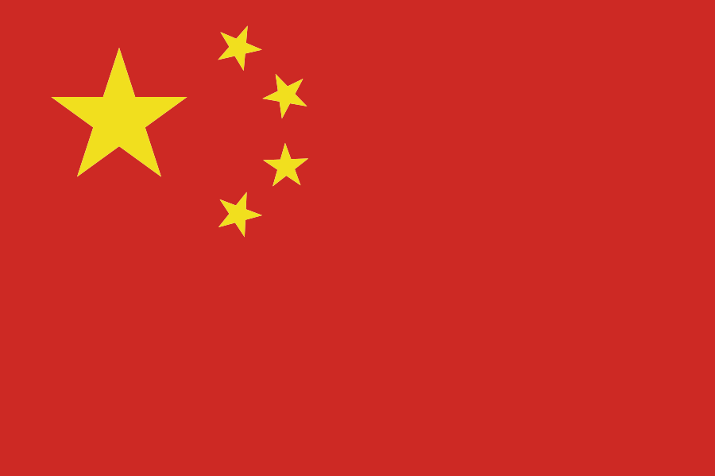

Chapter 35
THE UNITED NATIONS
First UN Peacekeeping mission begins in the Middle East while the UN Declaration of Human Rights and the Genocide Convention are adopted.
1994: Rwandan Genocide
1994-2015: International Criminal Tribunal for Rwanda
Irish UN Peacekeeping Forces arrive in the Congo.
1945
1948
1955
1961
1991
1994
2006
Strand Two & Three: The History of the World
Chapter Thirty-Five: The United Nations
@MsDoorley
1991: First of the Yugoslavic Wars begins
1993-2017: International Criminal Tribunal for the former Yugoslavia
The United Nations is founded in California by 50 countries with five being permanent members; USA, UK, USSR, China and France.
Ireland becomes 63rd member of the United Nations.
The Human Rights Council is established.

Slide 3
Learning Outcomes
3.12 EVALUATE the role of a movement or organisation, such as the European Union or United Nations, in promoting international cooperation, justice and human rights
2.13 ANALYSE the evolution and development of Ireland’s links with Europe.
Strand Two & Three: The History of the World
Chapter Thirty-Five: The United Nations
@MsDoorley

Slide 4
Introduction
In the wake of World War II, a world torn apart by conflict yearned for a new paradigm of peace and cooperation. The war had resulted in millions of lives lost and widespread devastation. Amidst this chaos, and with the shadow of the Cold War looming, the United Nations (UN) was established in 1945. Created as a platform for fostering international peace, human rights, and development, the UN aimed to ensure that the world would never again experience such catastrophic conflicts as it had in the span of 30 years when the world was flung into the First and Second World Wars. In its present form, the UN represents a global effort to make war obsolete and to build a future grounded in mutual respect and collaboration.
Strand Two & Three: The History of the World
Chapter Thirty-Five: The United Nations
@MsDoorley

Slide 5
1945 to Present
Chapter 35
35.1: THE ORIGINS OF THE UNITED NATIONS
35.1: the origins of the united nations
Strand Two & Three: The History of the World
@MsDoorley

Slide 6
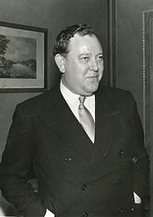

The path to international co-operation
The United Nations (UN) is an organisation that was created to promote international co-operation between different countries to prevent war. The UN also works to maintain justice and protect human rights.
In April 1945, delegates from 50 countries met in San Francisco, California, to organise the United Nations. In June, they completed the United Nations Charter or founding documents. On 24th October 1945, the United Nations officially began work.
The day-to-day administration of the UN is carried out by the Secretariat. This is led by the Secretary-General. Norwegian politician Trygve Lie was the first Secretary-General of the UN.
The United Nations has grown from 51 Member States in 1945 (Poland signed the Charter in October 1945), to 193 Member States in 2021.
Strand Two & Three: The History of the World
Chapter Thirty-Five: The United Nations
Diagram taken from Making History, 2nd Edition by Stacy Stout and Dermot Lucey (Gill Education)
@MsDoorley

Slide 7
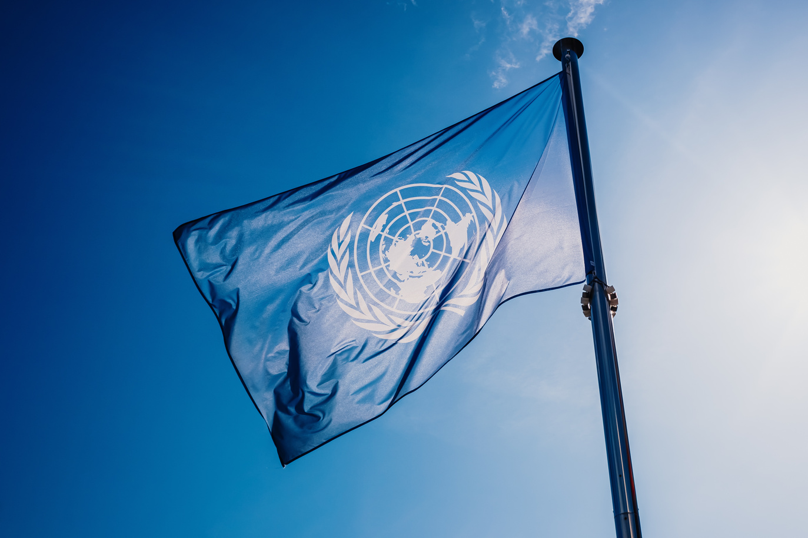
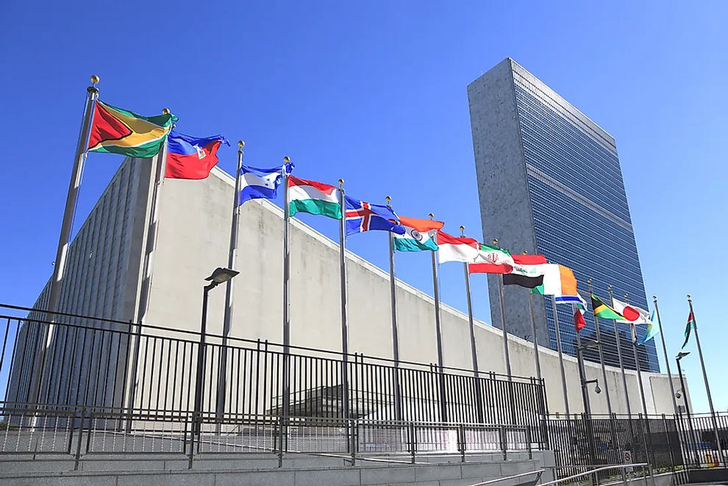
Strand Two & Three: The History of the World
Chapter Thirty-Five: The United Nations
Diagram taken from Making History, 2nd Edition by Stacy Stout and Dermot Lucey (Gill Education)
@MsDoorley

Slide 8
Questions pg. 27B3 (Making History, 2nd Edition)
  Correct each of the following statements in your copy book.
    The UN officially began work on 24 November 1945.
    The day-to-day administration of the UN is carried out by the President of the General Assembly.
    António Guterres was the first Secretary-General of the UN.
    The UN had 198 Member States in 2021.
    Ireland was the 70th country to join the UN.
  What is international co-operation?
Strand Two & Three: The History of the World
Chapter Thirty-Five: The United Nations
@MsDoorley

Slide 9
1945 to Present
Chapter 35
35.2: UN AND INTERNATIONAL CO-OPERATION
35.2: un and international co-operation
Strand Two & Three: The History of the World
@MsDoorley

Slide 10
How the UN Promotes international co-operation
The United Nations (UN) promotes international co-operation in various ways:
The International Court of Justice
The UN Office on Drugs and Crime
The General Assembly
How does the UN Promote International Co-operation?
UN Security Council
Other ways the UN promotes international co-operation:
Strand Two & Three: The History of the World
Chapter Thirty-Five: The United Nations
Peacekeepers
Economic and Social Council
Human Rights Council
United Nations International Children's Emergency Fund
WHO
UNESCO
ILO
IMF
Diagram taken from Making History, 2nd Edition by Stacy Stout and Dermot Lucey (Gill Education)
@MsDoorley

Slide 11

The General Assembly
The General Assembly is the main body of the United Nations. It is made up of all 193 Member States. They discuss, debate and make recommendations on international issues such as peace, security, human rights and international law.
  Each Member State has one vote in the Assembly.
  Decisions on important issues requite two-thirds majority.
Strand Two & Three: The History of the World
Chapter Thirty-Five: The United Nations
@MsDoorley

Slide 12

UN Security Council
The Security Council is the part of the UN responsible for peace making and peacekeeping.
  It can also impose international sanctions or punishments, e.g. since 2006, the UN has passed many sanctions against North Korea for developing nuclear weapons and related activities.
  Another role is to promote and support justice.
  At times, it also deals with grave human rights violations.
There are five permanent members of the Council (USA, China, Russia, France, UK). There are ten non-permanent members. Non-permanent members serve for two years on rotation. In 2021, Ireland became one of these.
  Decisions made by the Council need a majority vote and all permanent members must agree. This effectively gives permanent members the power to veto (stop) a decision. This power of veto has often made it difficult for the Security Council to make decisions, especially during the Cold War.
Strand Two & Three: The History of the World
Chapter Thirty-Five: The United Nations
@MsDoorley

Slide 13
UN Peacekeepers
Peacekeepers, also known as 'Blue Helmets', are not a regular army. They are representatives from various Member States who help to maintain peace in areas of conflict or unrest. As well as being an example of international co-operation, they can also be viewed as a group responsible for the promotion of justice and human rights. The Security Council usually authorises peacekeeping operations.
All UN Member States share the costs of peacekeeping.
Peacekeepers can be military, police and civilian personnel. They work together to maintain or restore world peace and security. Activities include:
  Monitoring ceasefires
  Protecting civilians
  Protecting human rights
  Promoting the rule of law
More than one million men and women have served under the UN Flag since 1948.
Strand Two & Three: The History of the World
Chapter Thirty-Five: The United Nations
@MsDoorley

Slide 14
First Peacekeeping Mission
After WWI, Britain took control of Palestine, an area of the eastern Mediterranean. This was known as the British Mandate for Palestine. Between the 1920s and 1940s, the number of Jewish people arriving in the Palestine grew, leading to increased clashes between Jews and Arabs. In 1947, the UN proposed that Palestine would be divided between Jews and Arabs; this plan was rejected by the Palestinians.
When British rulers left Palestine in 1948, Jewish leaders declared the creation of the state of Israel. Many Palestinians objected and the Arab-Israeli War followed. Troops from neighbouring Arab countries (Egypt, Jordan, Iraq, Syria and Lebanon) invaded. The first UN Peacekeeping mission began in 1948 when the UN Security Council sent Peacekeepers to the Middle East.
Eventually a truce was agreed between Israel and four neighbouring states: Egypt, Syria, Jordan and Lebanon. Around 800,000 Palestinians were now living as refugees and Israel was in control of most of the territory.
This truce did not bring lasting peace to the region and it became a site of Cold War tension, e.g. Egypt was often supported by the Soviet Union while Israel was backed by the United States. There were further wars in the area, including in 1956, 1967, 1973, 1982 and most recently since 7th October 2023. Conflict still exists between Israel and Palestine, with Israeli military and Palestinian group Hamas regularly attacking each other and both sides committing mass atrocities against each other.
Strand Two & Three: The History of the World
Chapter Thirty-Five: The United Nations
@MsDoorley

Slide 15
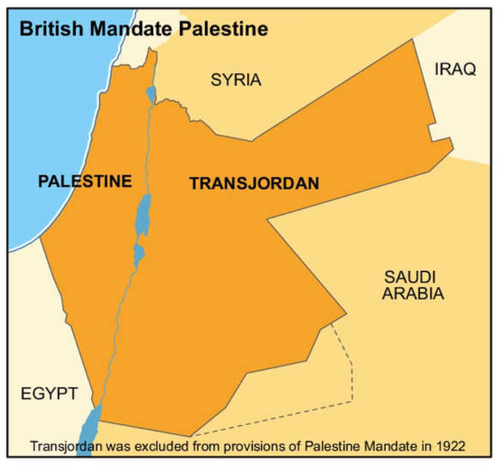
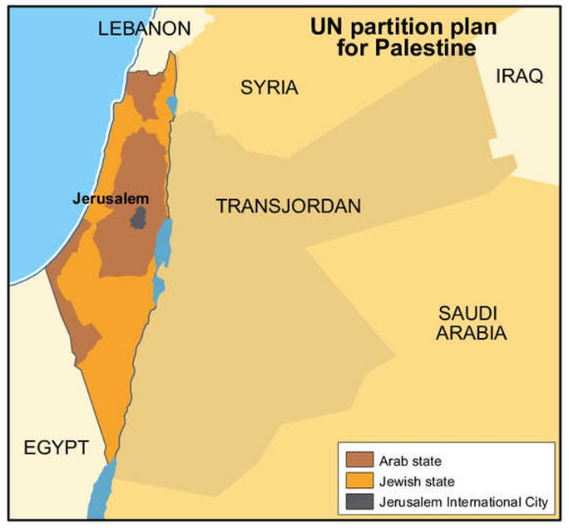
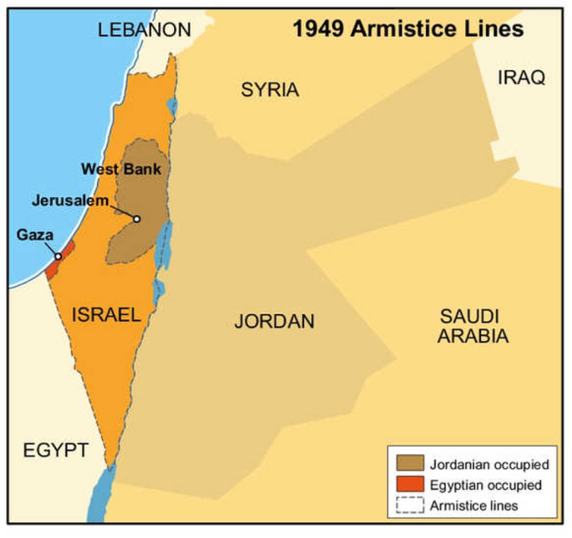
Strand Two & Three: The History of the World
Chapter Thirty-Five: The United Nations
Diagram taken from Making History, 2nd Edition by Stacy Stout and Dermot Lucey (Gill Education)
@MsDoorley

Slide 16
Yugoslavian Wars
In the aftermath of WWII, the nation of Yugoslavia was formed under the leadership of Josip Broz Tito. Yugoslavia was a federation of six republics: Slovenia, Croatia, Bosnia and Herzegovina, Montenegro, Macedonia, and Serbia, which included the autonomous provinces of Kosovo and Vojvodina. For decades, the country maintained a delicate balance among the various ethnic and religious groups residing within its borders. However, after Tito's death in 1980 and under the weight of economic and political pressures, the federation began to disintegrate in the 1990s. Nationalistic sentiments flared, particularly in Serbia under Slobodan Milošević, and violent conflicts erupted, leading to what is now known as the Yugoslavian Wars.
The UN became involved in 1992 when the Security Council established the United Nations Protection Force (UNPROFOR) to create safe areas in Croatia and later expanded to Bosnia and Herzegovina. This was the first mission of its kind for the UN and marked a shift in the UN peacekeeping operations.
Despite UN efforts, the Bosnian War witnessed one of the worst atrocities in Europe since WWII, with the Srebrenica massacre in 1995 where more than 8,000 Bosniak men and boys were killed by Bosnian Serb forces, despite the area being declared a "safe haven" by the UN.
Strand Two & Three: The History of the World
Chapter Thirty-Five: The United Nations
@MsDoorley

Slide 17
Yugoslavian Wars
Eventually, the Dayton Accords were signed in 1995, effectively ending the Bosnian War. However, the tensions in the region persisted, especially in Kosovo. The UN established the United Nations Interim Administration Mission in Kosovo (UNMIK) following the 1999 NATO bombing campaign against Yugoslavia to end the violence and persecution of ethnic Albanians by Serbian forces.
In the aftermath of these wars, more than 140,000 people were killed and millions were displaced. The region was severely destabilised, and the UN peacekeeping missions faced significant criticism for their inability to prevent mass atrocities. The International Criminal Tribunal for the former Yugoslavia took place to punish the war crimes that took place throughout the Yugoslavian wars, which we will look at later.
Strand Two & Three: The History of the World
Chapter Thirty-Five: The United Nations
@MsDoorley

Slide 18
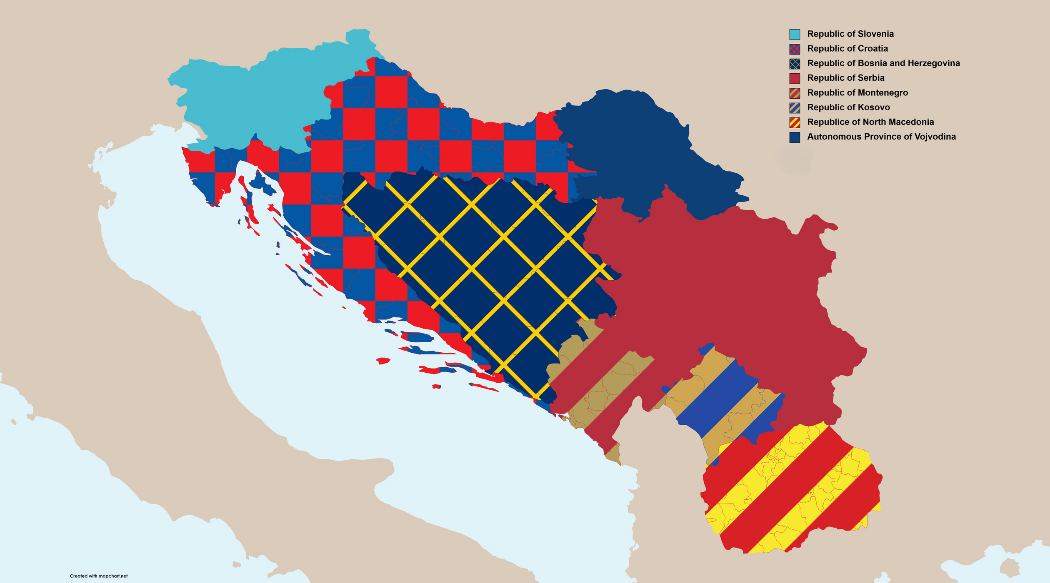
Austria
Hungary
Slovenia
Romania
Croatia
Vojvodina
Bosnia-Hercegovina
Strand Two & Three: The History of the World
Serbia
Chapter Thirty-Five: The United Nations
San Marino
Macedonia
Bulgaria
Kosovo
Italy
Macedonia
Albania
Greece
@MsDoorley

Slide 19
Other Peacekeeping missions | Other Peacekeeping missions
United Nations Operation in the Congo (ONUC) (1960-1964) | United Nations Mission in Sudan (UNMIS) (2005-2011)
United Nations Emergency Force (UNEF) II (1973-1979) | United Nations Interim Security Force for Abyei (UNISFA) (2011-present)
United Nations Interim Force in Lebanon (UNIFIL) (1978-present) | United Nations Mission in South Sudan (UNMISS) (2011-present)
United Nations Angola Verification Mission (UNAVEM) I, II, and III (1989-1997) | United Nations Multidimensional Integrated Stabilization Mission in Mali (MINUSMA) (2013-present)
United Nations Observer Mission in El Salvador (ONUSAL) (1991-1995) | United Nations Mission for Ebola Emergency Response (UNMEER) (2014-2015)
United Nations Operation in Somalia (UNOSOM) I and II (1992-1995) | United Nations Multidimensional Integrated Stabilization Mission in the Central African Republic (MINUSCA) (2014-present)
United Nations Mission in Haiti (UNMIH) (1993-1996) | United Nations Verification Mission in Colombia (UNVMC) (2017-present)
United Nations Preventive Deployment Force (UNPREDEP) in Macedonia (1995-1999) | United Nations Integrated Transition Assistance Mission in Sudan (UNITAMS) (2020-present)
United Nations Mission in Sierra Leone (UNAMSIL) (1999-2006) | United Nations Mission to Support the Hudaydah Agreement (UNMHA) (2019-present)
United Nations Mission in Liberia (UNMIL) (2003-2018) | United Nations Truce Supervision Organization (UNTSO) (1948-present)
Strand Two & Three: The History of the World
Chapter Thirty-Five: The United Nations
@MsDoorley

Slide 20




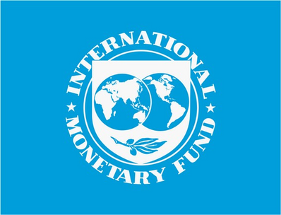
Economic and Social Council (ECOSOC)
The Economic and Social Council was created in 1945. ECOSOC's 54 members promote international co-operation by discussing international social and economic issues. They review the implementation of the Sustainable Development Goals (SDGs).
  The SDGs are 17 global goals designed to create a better future for all.
  SDGs include no poverty, zero hunger and climate action.
  They are an example of how the UN promotes human rights.
ECOSOC are in control of many specialist agencies including:
  World Health Organisation (WHO)
  United Nations Educational, Scientific and Cultural Organisation (UNESCO)
  International Labour Organisation (ILO)
  International Monetary Fund (IMF)
Strand Two & Three: The History of the World
Chapter Thirty-Five: The United Nations
@MsDoorley

Slide 21
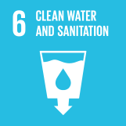


Strand Two & Three: The History of the World
Chapter Thirty-Five: The United Nations
@MsDoorley

Slide 22

World Health Organisation (WHO)
The World Health Organisation works with Member States to improve health and well-being across the world by providing information, running awareness campaigns and supplying medical materials to countries in need. It is partly funded by Member States.
Strand Two & Three: The History of the World
Chapter Thirty-Five: The United Nations
@MsDoorley

Slide 23
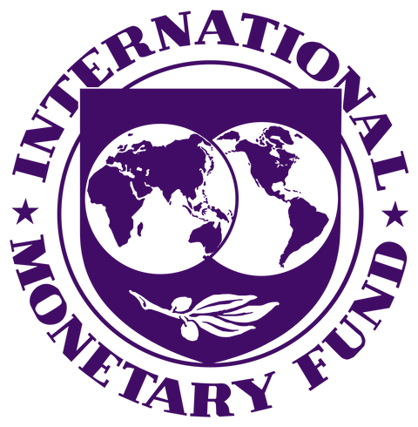
Other ways the UN Promotes International Co-Operation | Other ways the UN Promotes International Co-Operation
United Nations Educational, Scientific and Cultural Organisation (UNESCO) | Aims to promote peace between different countries through education, science and culture.
International Labour Organisation (ILO) | Deals with labour issues. Aims include setting labour standards.
International Monetary Fund (IMF) | An international organisation that helps Member States by providing loans to countries in economic crisis.
The International Court of Justice | Court made up of 15 judges from different nations.
The UN Office on Drugs and Crime | Has 20 field offices that cover over 150 countries.
United Nations International Children's Emergency Fund | Works in over 190 countries to save children's lives, defend their rights and achieve their potential.
Human Rights Council | Made up of 47 Member States. Promotes and protects human rights around the world.
Strand Two & Three: The History of the World
Chapter Thirty-Five: The United Nations
Did you know?
The IMF and the European Union provided Ireland with a loan of €67.5 billion in November 2010. Ireland repaid the IMP in 2017.
@MsDoorley

Slide 24
Questions pg. 27B6 (Making History, 2nd Edition)
  Who are the permanent members of the UN Security Council?
  How has the power of veto made it difficult for the UN Security Council to make decisions?
  Where were Irish troops first deployed as Peacekeepers?
  What are the Sustainable Development Goals?
  What does 'WHO' stand for?
Strand Two & Three: The History of the World
Chapter Thirty-Five: The United Nations
@MsDoorley

Slide 25
1945 to Present
Chapter 35
35.3: UN AND JUSTICE
35.3: un and justice
Strand Two & Three: The History of the World
@MsDoorley

Slide 26
How the UN Promotes Justice
The International Court of Justice
International Criminal Tribunal for the former Yugoslavia (ICTY)
How does the UN Promote International Justice?
International Criminal Tribunals
The UN Office on Drugs and Crime
Strand Two & Three: The History of the World
Chapter Thirty-Five: The United Nations
International Criminal Tribunal for Rwanda (ICTR)
Other ways the UN promotes justice:
General Assembly
UN Security Council
Peacekeepers
Diagram taken from Making History, 2nd Edition by Stacy Stout and Dermot Lucey (Gill Education)
@MsDoorley

Slide 27

The International Court of Justice
The International Court of Justice was established in 1945 by the Charter of the United Nations. It is based in the Hague in the Netherlands. The court is made up of 15 judges. Each judge must be from a different nation. The General Assembly works with the Security Council to elect these judges.
The court settles disputes submitted by UN Member States. The court can also give its opinion on legal questions submitted by the United Nations.
Strand Two & Three: The History of the World
Chapter Thirty-Five: The United Nations
Diagram taken from Making History, 2nd Edition by Stacy Stout and Dermot Lucey (Gill Education)
@MsDoorley

Slide 28
The International Criminal Tribunal: ICTY
The International Criminal Tribunal for the former Yugoslavia (ICTY) was established by the United Nations in 1993. Its creation stemmed from the urgent need to address the grave atrocities committed during the conflicts that erupted following the disintegration of the former Yugoslavia in the early 1990s. Among these conflicts, the Bosnian War (1992-1995) remains one of the most notorious, particularly due to the Bosnian genocide.
During this period, Bosnian Serb forces, which were supported by the Yugoslav army, predominantly targeted Bosniak (Bosnian Muslim) and Croatian civilians. It's estimated that around 100,000 individuals lost their lives from 1992 to 1995, with Bosniaks making up a staggering 80% of that total.
The primary function of the ICTY was to investigate and prosecute individuals for a range of serious crimes. These included genocide and complicity in genocide, crimes against humanity, grave breaches of the Geneva Conventions, and violations of the laws or customs of war. Additionally, the tribunal aimed to promote reconciliation among the former Yugoslav states and bolster international jurisprudence on genocide and other violations of international humanitarian law.
In its tenure, the Tribunal indicted 161 individuals. Out of those, ninety were sentenced. One of the most prominent figures brought before the ICTY was Ratko Mladić, the former Commander of the Bosnian Serb Army. Mladić faced a guilty verdict on 10 charges, which included his involvement in the genocide in Srebrenica, where over 7,000 Bosniak men and boys were mercilessly executed. He was subsequently sentenced to life imprisonment.
Strand Two & Three: The History of the World
Chapter Thirty-Five: The United Nations
@MsDoorley

Slide 29

The International Criminal Tribunal: ICTY
As of today, while significant progress has been made in the region, tensions and issues persist. Serbia, for example, still does not recognise Kosovo's independence, declared in 2008. The legacy of the Yugoslavian Wars and the ICTY's operations continue to have had a lasting impact on international law and geopolitics of the region. It marked the first occasion since the Nuremberg and Tokyo Tribunals where international leaders were held accountable and prosecuted for war crimes and other egregious violations. This groundbreaking tribunal set the stage for other international judiciaries, such as the International Criminal Tribunal for Rwanda (ICTR) and the International Criminal Court (ICC). While the ICTY formally concluded its activities in 2017, its residual functions, including those concerning trials, appeals, witness protection, and sentence supervision, transitioned to the Mechanism for International Criminal Tribunals (MICT).
Strand Two & Three: The History of the World
Chapter Thirty-Five: The United Nations
Macedonia
Montenegro
Croatia
Serbia
Yugoslavia
Bosnia and Herzegovina
Kosovo
Flag of Vojvodina
Slovenia
@MsDoorley

Slide 30
Timeline of the Yugoslavian Wars
Year | Conflict | Dates | Duration | Event
1991 | Slovenian War of Independence | 27 June – 7 July 1991 | 1 week and 3 days | Slovenia and Croatia declare independence from Yugoslavia. Ten-Day War in Slovenia.
 | Croatian War of Independence | 31 March 1991 – 12 November 1995 | 4 years, 7 months, 1 week and 5 days | Croatian War of Independence begins.
 | Macedonian Independence | 1991 | Largely peaceful | The Republic of Macedonia (today North Macedonia) declares independence.
1992 | Bosnian War | 6 April 1992 – 14 December 1995 | 3 years, 8 months, 1 week and 6 days | Bosnia and Herzegovina declare independence. Bosnian War begins. UNPROFOR dispatched to the region.
1993 | - | - | - | Bosnian War intensifies, especially the Siege of Sarajevo.
1994 | - | - | - | NATO becomes more involved, particularly through airstrikes against Bosnian Serb positions.
1995 | Insurgency in Kosovo | 27 May 1995 – 27 February 1998 | 2 years and 9 months | Srebrenica massacre occurs. Operation Storm is launched. Dayton Agreement is signed.
1996 | - | - | - | Peace largely holds in Bosnia.
1998 | Kosovo War | 28 February 1998 – 11 June 1999 | 1 year, 3 months and 2 weeks | Kosovo War begins as conflict between the KLA and Yugoslav forces.
1999 | Insurgency in the Preševo Valley | 12 June 1999 – 1 June 2001 | 1 year, 11 months, 2 weeks and 6 days | NATO launches an aerial campaign against Yugoslavia. Kumanovo Agreement is signed. UNMIK is established.
2000 | - | - | - | Political changes in Yugoslavia, Milošević is ousted from power.
2001 | Insurgency in Macedonia | 22 January – 12 November 2001 | 9 months and 3 weeks | Insurgency in Macedonia; clashes between ethnic Albanians and Macedonian forces.
Strand Two & Three: The History of the World
Chapter Thirty-Five: The United Nations
@MsDoorley

Slide 31
Timeline of the Yugoslavian Wars
Conflict/Aspect | Total Estimated Deaths | Breakdown
General Estimates | Between 130,000-140,000
By Region/Conflict | By Region/Conflict | By Region/Conflict
Slovenian War | 70 | -
Croatian War | 22,000 | 15,000 Croats 7,000 Serbs
Bosnian War | 97,207 - 102,622 | 64,036 Bosniaks (65%) 24,905 Serbs (25%) 7,788 Croats (8%)
Siege of Sarajevo | 14,000 | -
Kosovo Conflict | 13,535 | 10,812 Albanians (80%) 2,197 Serbs (16%)
Specific Groups & Incidents | Specific Groups & Incidents | Specific Groups & Incidents
Bosniaks Total Deaths (Bosnian War) | 64,036 | Represents over 3% of the entire Bosniak ethnic group
Srebrenica Massacre (July 1995) | 7,000-8,000 | Bosniak male mortality rate reached 33%
Bosniak Civilian Fatalities (Bosnian War) | Not specified | Share among all civilian fatalities: ~83%, rising to almost 95% in Eastern Bosnia
Croatian Civilian Fatalities (Croatian War) | Not specified | 43.4% of the total Croatian casualties were civilians
NATO's Operation Allied Force (1999) | Debated numbers Yugoslav official figures: 3,500 Human Rights Watch: 1,600 approx. | Yugoslav Figures 1,000 soldiers 1,200-2,500 civilians Human Rights Watch Figures Less than 1,000 soldiers 500-600 civilians
Strand Two & Three: The History of the World
Chapter Thirty-Five: The United Nations
@MsDoorley

Slide 32
The International Criminal Tribunal: ICTR
The International Criminal Tribunal for Rwanda (ICTR) was a groundbreaking judicial body instituted by the United Nations in 1994. Its establishment was in response to the heinous crimes committed during the Rwandan genocide, which saw the systematic extermination of the Tutsi population by the ethnic Hutu majority.
The Rwandan genocide began in April 1994 and lasted roughly 100 days. Triggered by the assassination of the Rwandan President Juvénal Habyarimana, a Hutu, the violence escalated rapidly, leading to widespread slaughter. In this period, it's estimated that between 500,000 and 1,000,000 Tutsis and moderate Hutus were brutally killed, largely at the hands of organised gangs and local militias known as the "Interahamwe."
The primary objective of the ICTR was to prosecute individuals responsible for heinous acts, such as genocide, crimes against humanity, and violations of international humanitarian law. The Tribunal was not restricted only to the genocide but also looked into crimes committed by the Rwandan Patriotic Front (RPF), the Tutsi-led rebel group.
Over its operation, the ICTR indicted 93 individuals, of which notable figures include Jean Kambanda, Rwanda's Prime Minister during the genocide, who became the first head of government to be convicted of genocide. Another significant figure is Colonel Théoneste Bagosora, deemed to be the mastermind behind much of the killing.
Strand Two & Three: The History of the World
Chapter Thirty-Five: The United Nations
@MsDoorley

Slide 33
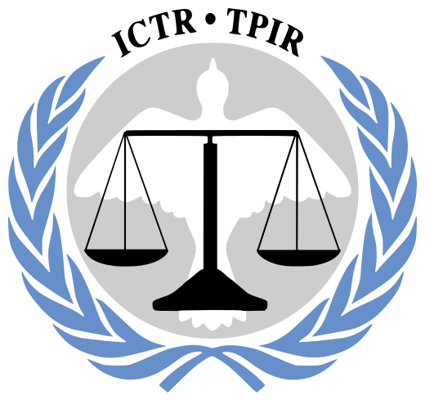
The International Criminal Tribunal: ICTR
The ICTR has had a profound impact on international criminal justice. As with its counterpart for the former Yugoslavia, the ICTR set important precedents. Notably, it was the first international tribunal to define rape in international criminal law and recognise rape as a means of perpetrating genocide.
The Tribunal officially concluded its work in 2015, and its functions were taken over by the Mechanism for International Criminal Tribunals (MICT), the same body that now oversees the residual functions of the ICTY.
Strand Two & Three: The History of the World
Chapter Thirty-Five: The United Nations
@MsDoorley

Slide 34

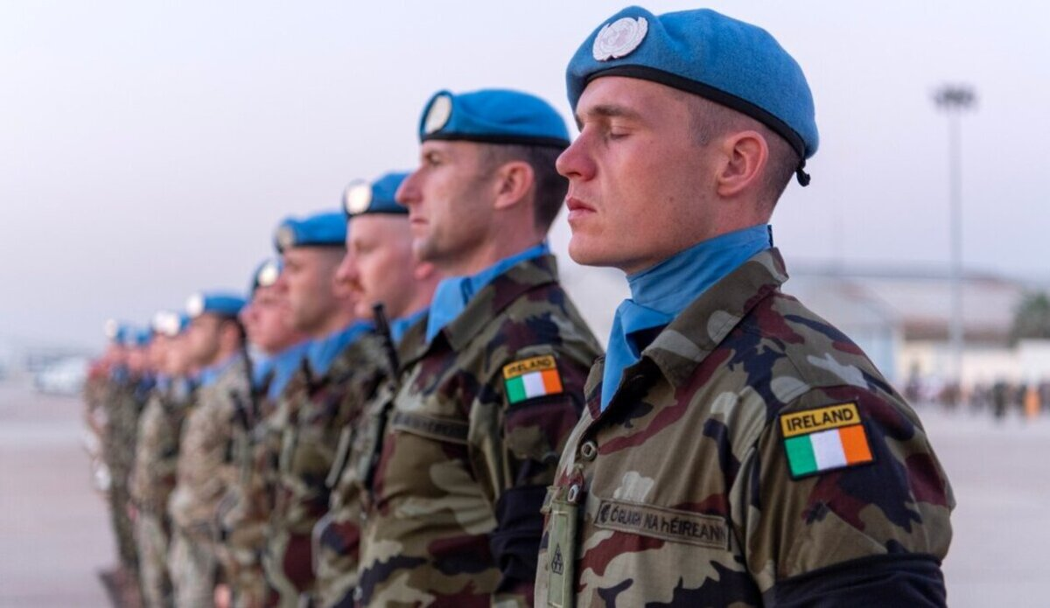

Other ways the UN Promotes Justice | Other ways the UN Promotes Justice
General Assembly | In the 1960s, the assembly suspended the South African delegation for violating Security Council resolutions and international laws.
UN Security Council | Many Security Council missions include strengthening the rule of law. The Security Council can decide when and where Peacekeepers should be deployed. Many peacekeeping missioning promote justice.
Peacekeepers | Most peacekeeping operations work to support the national police and promote justice.
Strand Two & Three: The History of the World
Chapter Thirty-Five: The United Nations
@MsDoorley

Slide 35
Questions pg. 27B9 (Making History, 2nd Edition)
  When was the International Court of Justice established?
  Identify two things the International Court of Justice does.
  Why was the ICTY set up?
  Name one person sentenced by the ICTY.
  Why was the ICTR established?
Strand Two & Three: The History of the World
Chapter Thirty-Five: The United Nations
@MsDoorley

Slide 36
1945 to Present
Chapter 35
35.4: THE UN AND HUMAN RIGHTS
35.4: the un and human rights
Strand Two & Three: The History of the World
@MsDoorley

Slide 37
How the UN Promotes Justice
Universal Declaration of Human Rights
United Nations Convention on the Rights of the Child
High Commissioner for Human Rights
How does the UN Promote Human Rights?
United Nations International Children's Emergency Fund
The UN Office on Drugs and Crime
Strand Two & Three: The History of the World
Chapter Thirty-Five: The United Nations
Commission on the Status of Women
The International Court of Justice
Other ways the UN promotes justice:
General Assembly
Security Council
Peacekeepers
ILO
Diagram taken from Making History, 2nd Edition by Stacy Stout and Dermot Lucey (Gill Education)
@MsDoorley

Slide 38
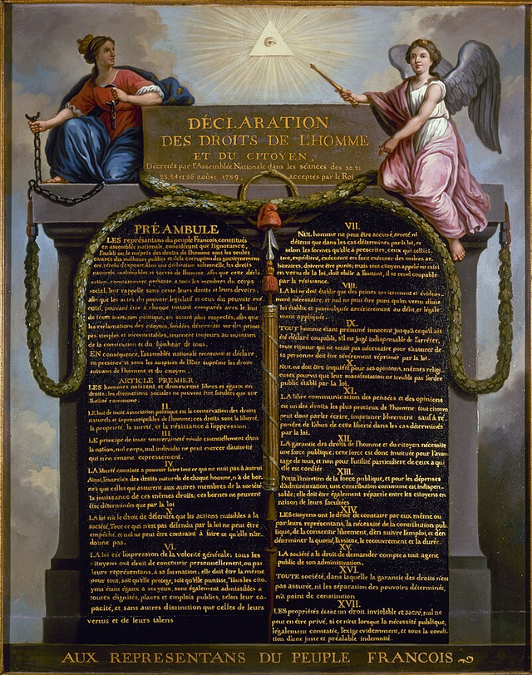
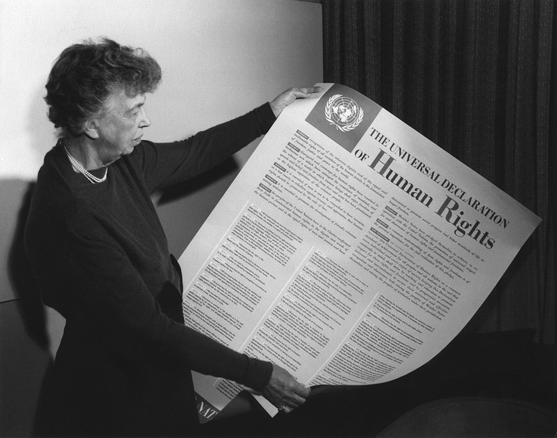
Universal Declaration of Human Rights (UDHR)
The events of World War II made many people realise that human rights are not always respected. In 1948, the UN General Assembly adopted the Universal Declaration of Human Rights (UDHR). This document, greatly inspired by the Declaration of the Rights of Man and Citizen that had been created during the 1789 French Revolution, outlines the rights that every person should have. The UDHR has 30 articles.
Strand Two & Three: The History of the World
Chapter Thirty-Five: The United Nations
Diagram taken from Making History, 2nd Edition by Stacy Stout and Dermot Lucey (Gill Education)
@MsDoorley

Slide 39
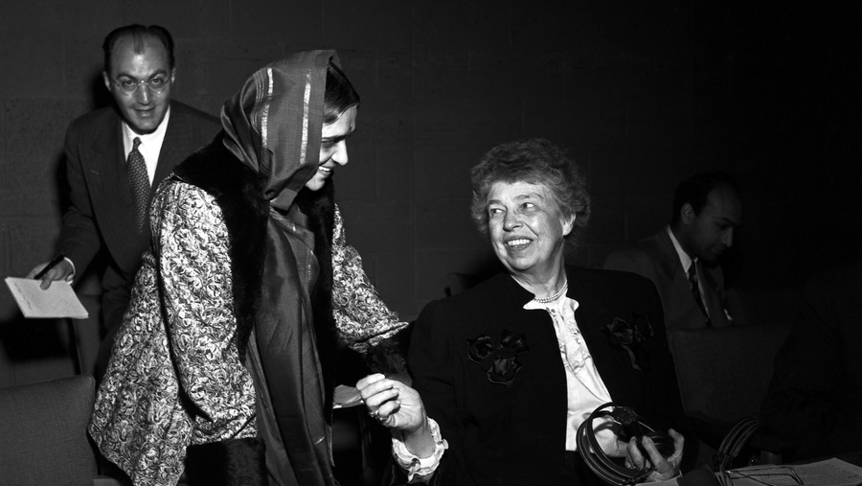
Eleanor Roosevelt and Hansa Mehta
Former First Lady of the United States, Eleanor Roosevelt (right), served as the first Chairperson of the Commission on Human Rights. She was heavily involved in drafting the UDHR. In 1968, she was posthumously awarded the United Nations Human Rights Prize.
Hansa Mehta of India (left) was the only other female delegate to the United Nations Commission on Human Rights in 1947-1948. She was a staunch fighter for women's rights in India and abroad. She is widely credited with changing the phrase 'All men are born free and equal' to 'All human beings are born free and equal' in Article 1.
Strand Two & Three: The History of the World
Chapter Thirty-Five: The United Nations
Diagram taken from Making History, 2nd Edition by Stacy Stout and Dermot Lucey (Gill Education)
@MsDoorley

Slide 40
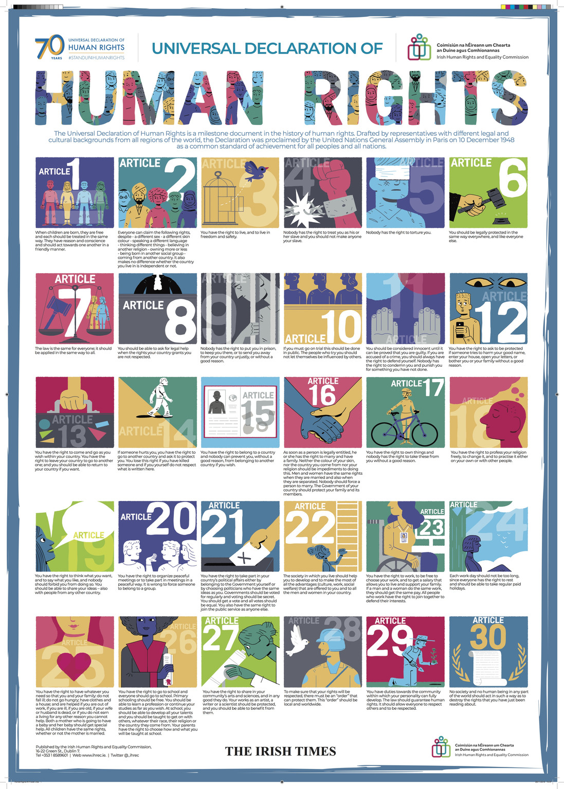
Universal Declaration of Human Rights (UDHR)
The Universal Declaration of Human Rights (UDHR) stands as a monumental document in the annals of human history, setting forth fundamental human rights that should be protected for all people. However, it's crucial to understand its legal nature. Unlike some international documents, such as the Geneva Conventions, the UDHR is not legally binding. This distinction means that states and entities are not under a legal obligation, enforced by international law, to implement its provisions.
While the UDHR doesn't carry the force of international law in the same way treaties do, its significance and influence cannot be understated. Over the decades since its adoption in 1948, the UDHR has played a pivotal role in shaping the global human rights discourse. Many of its principles have been incorporated into subsequent international treaties, regional human rights documents, and national constitutions and legal frameworks. This has resulted in the UDHR acting as a moral compass and foundational text for the development of international human rights law.
Furthermore, the spirit and principles of the UDHR have often been invoked by activists, governments, and international bodies to highlight and condemn human rights abuses. Even without the binding force of law, the UDHR's impact has been profound, with its principles serving as a touchstone for global efforts to promote and safeguard human dignity, freedom, and equality.
Strand Two & Three: The History of the World
Chapter Thirty-Five: The United Nations
@MsDoorley

Slide 41
Universal Declaration of Human Rights (UDHR)
Article 1: All human beings are born free and equal in dignity and rights. | Article 11: Everyone charged with a crime has the right to be presumed innocent until proven guilty. | Article 21: Everyone has the right to take part in government and access public services.
Article 2: Everyone is entitled to all the rights and freedoms set forth in this Declaration without distinction of any kind. | Article 12: No one shall be subjected to arbitrary interference with privacy, family, home, or correspondence. | Article 22: Everyone, as a member of society, has the right to social security.
Article 3: Everyone has the right to life, liberty, and security of person. | Article 13: Everyone has the right to freedom of movement and residence within the borders of each state. | Article 23: Everyone has the right to work, to free choice of employment, to just and favourable conditions of work.
Article 4: No one shall be held in slavery or servitude. | Article 14: Everyone has the right to seek asylum from persecution in other countries. | Article 24: Everyone has the right to rest and leisure.
Article 5: No one shall be subjected to torture or to cruel, inhuman, or degrading treatment or punishment. | Article 15: Everyone has the right to a nationality. | Article 25: Everyone has the right to a standard of living adequate for health and well-being.
Article 6: Everyone has the right to recognition everywhere as a person before the law. | Article 16: Men and women have the right to marry and found a family. | Article 26: Everyone has the right to education.
Article 7: All are equal before the law and are entitled to equal protection of the law. | Article 17: Everyone has the right to own property. | Article 27: Everyone has the right to participate in the cultural life of the community and benefit from scientific advancements.
Article 8: Everyone has the right to an effective remedy by the competent national tribunals for acts violating fundamental rights. | Article 18: Everyone has the right to freedom of thought, conscience, and religion. | Article 28: Everyone is entitled to a social and international order in which these rights can be realised.
Article 9: No one shall be subjected to arbitrary arrest, detention, or exile. | Article 19: Everyone has the right to freedom of opinion and expression. | Article 29: Everyone has duties to the community and is subject to limitations for the purpose of securing due recognition for the rights and freedoms of others.
Article 10: Everyone is entitled to a fair and public hearing by an independent tribunal. | Article 20: Everyone has the right to freedom of peaceful assembly and association. | Article 30: Nothing in this Declaration may be interpreted as implying for any State, group, or person any right to perform any act aimed at the destruction of any of the rights and freedoms set forth herein.
Strand Two & Three: The History of the World
Chapter Thirty-Five: The United Nations
@MsDoorley

Slide 42
United Nations International Children's Emergency Fund (UNICEF)
To help children affected by WWI, the UN General Assembly established the International Children's Emergency Fund (UNICEF) in 1946. UNICEF works in over 190 countries to save children's lives, defend their rights and help them to achieve their potential. UNICEF works to achieve this in many different ways including:
Promoting gender equality | e.g. Girls in Tech is an organisation focused on the engagement, education and empowerment of women in technology
Reducing child mortality | e.g. supplies vaccines to reach 45% of the world's children under five
Working to end the use of child soldiers | e.g. helping reunify child soldiers with their families
Strand Two & Three: The History of the World
Chapter Thirty-Five: The United Nations
@MsDoorley

Slide 43
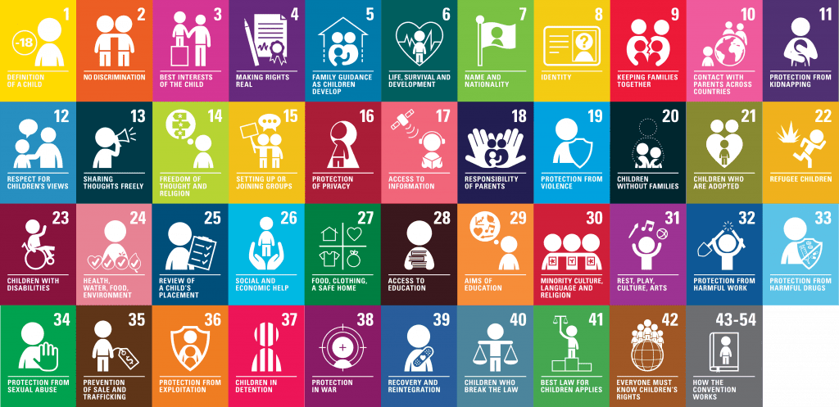
United Nations Convention on the Rights of the Child (UNCRC)
In 1989, the Convention on the Rights of the Child was adopted by the UN General Assemby. The UNCRC guarantees and sets minimum standards for protecting the rights of children. It is the most widely ratified human rights treaty in history, with 41 articles.
The UN has also adopted a series of other conventions such as the elimination of discrimination against women (1979) and the rights of persons with disabilities (2006).
Strand Two & Three: The History of the World
Chapter Thirty-Five: The United Nations
@MsDoorley

Slide 44
Other ways the UN Promotes Justice | Other ways the UN Promotes Justice
Commission on the Status of Women (CSW) | Promotes gender equality and the advancement of women
United Nations High Commissioner for Refugees (UNHCR) | Helps people forced to flee their homes and has staff in over 130 countries
High Commissioner for Human Rights (OHCHR) | Leads UN activity on human rights issues. Former Irish President Mary Robinson was UN High Commissioner for Human Rights from 1997-2002.
The Human Rights Council | Promotes and protects human rights Every four years, it reviews the human rights records of the 193 UN Member States.
General Assembly | Condemns human rights abuses
Security Council | The Security Council has created several resolutions (official opinions) on human rights issues
Peackeepers | Many peacekeeping missions have a human rights team.
ILO | Works to improve the rights of workers.
Strand Two & Three: The History of the World
Chapter Thirty-Five: The United Nations
Diagram taken from Making History, 2nd Edition by Stacy Stout and Dermot Lucey (Gill Education)
@MsDoorley

Slide 45
Questions pg. 27B11 (Making History, 2nd Edition)
  What are human rights?
  What role did (i) Eleanor Roosevelt and (ii) Hansa Mehta have in the drafting of the Universal Declaration of Human Rights?
  How does UNICEF work to reduce child morality?
  Why was the United Nations High Commissioner for Refugees set up?
  What is the most widely ratified human rights treaty in history?
  Name one former UN High Commissioner for Human Rights.
Strand Two & Three: The History of the World
Chapter Thirty-Five: The United Nations
@MsDoorley

Slide 46
1945 to Present
Chapter 35
35.5: IRELAND AND THE UN
35.5: ireland and the un
Strand Two & Three: The History of the World
@MsDoorley

Slide 47
Ireland Joins the United Nations
Ireland became the 63rd member of the United Nations on 14th December 1955. This marked a significant moment in Irish history, as the country moved away from its long-standing neutrality following World War II to engage actively in international diplomacy. Membership of the UN allowed Ireland to contribute to global discussions on peace, justice, and human rights, giving it a voice on the world stage. By joining the UN, Ireland signalled its commitment to working collaboratively with other nations to address global challenges.
Strand Two & Three: The History of the World
Chapter Thirty-Five: The United Nations
@MsDoorley

Slide 48
Ireland and UN Peacekeeping
Ireland has a proud tradition of contributing to UN peacekeeping missions, beginning with its first deployment to the Congo in 1960 during Operation ONUC. Since then, Irish peacekeepers, often referred to as “Blue Helmets”, have gained an international reputation for their neutrality and dedication to protecting civilians. Over 70,000 Irish men and women have served in peacekeeping missions across the globe, including in Cyprus, Lebanon, and Syria. These missions reflect Ireland’s commitment to promoting international peace and security, often in regions of significant conflict and unrest.
Strand Two & Three: The History of the World
Chapter Thirty-Five: The United Nations
@MsDoorley

Slide 49
Ireland’s Advocacy in the United Nations
Ireland has used its UN membership to play a leading role in global initiatives. The country has served as a non-permanent member of the UN Security Council on four occasions, most recently from 2021 to 2022, where it advocated for human rights and conflict resolution.
In 2015, Ireland co-chaired the negotiations that led to the adoption of the Sustainable Development Goals (SDGs), a framework for tackling global challenges such as poverty and climate change.
Former Irish President Mary Robinson further enhanced Ireland’s reputation within the UN by serving as the UN High Commissioner for Human Rights from 1997 to 2002, focusing on justice and equality worldwide.
Strand Two & Three: The History of the World
Chapter Thirty-Five: The United Nations
@MsDoorley

Slide 50
1945 to Present
Chapter 35
35.6: SUMMARY
35.6: summary
Strand Two & Three: The History of the World
@MsDoorley

Slide 51
In this chapter, we have learned that...
  Founded in 1945, the United Nations (UN) was established with the primary goal of fostering international co-operation, preventing wars, ensuring justice, and safeguarding human rights. Originally beginning with 51 Member States, the organization grew to encompass 193 members by 2021. Trygve Lie took on the esteemed role of its first Secretary-General, overseeing the Secretariat responsible for day-to-day operations.
  Central to the UN's operations is the General Assembly. Here, all 193 Member States gather to discuss and deliberate on pressing global issues. Each state holds a single vote, and major decisions necessitate a two-thirds majority. Additionally, the Security Council, another pivotal component, focuses on upholding international peace. It comprises five permanent members, each wielding the influential power of a veto.
  The UN's peacekeeping forces, colloquially termed the 'Blue Helmets', play a vital role in ensuring tranquility in conflict zones. These troops, contributed by member states, are dispatched to areas of unrest. The financial cost of these missions is shared among the member nations.
  Historically, the UN has been significantly involved in numerous global conflicts. Since 1948, the Israel-Palestine Conflict has consistently occupied the organization's attention, serving as a persistent point of international contention. Another major engagement was in Yugoslavia during the 1990s. The UN's role during the Yugoslav Wars faced scrutiny, primarily due to its perceived ineffectiveness in curbing severe atrocities.
Strand Two & Three: The History of the World
Chapter Thirty-Five: The United Nations
@MsDoorley

Slide 52
In this chapter, we have learned that...
  The Economic and Social Council (ECOSOC) propels the UN's efforts in promoting international cooperation on socio-economic fronts. ECOSOC's undertakings are epitomised by the Sustainable Development Goals (SDGs) – a set of 17 objectives aiming at a prosperous future for all. Operating under ECOSOC are specialised agencies, including the WHO, UNESCO, ILO, and IMF.
  The UN is also vested in global judiciary matters, with the International Court of Justice at its helm. Established in 1945, this court arbitrates disputes between nations. In response to specific global conflicts, the UN also founded the International Criminal Tribunals for both Yugoslavia (1993) and Rwanda (1994) to address heinous war crimes.
  Championing human rights is core to the UN's mission. The Universal Declaration of Human Rights (UDHR), adopted in 1948, is a testament to this commitment. Drawing from the 1789 French Declaration, the UDHR lists 30 articles of universal rights. Although not legally binding, its influence on worldwide human rights discourse is undeniable.
  Adopted in 1989, the Convention on the Rights of the Child (CRC) is a pivotal UN treaty championing children's rights across civil, political, economic, and social domains. This convention emphasises safeguarding the best interests of children in all actions. Facilitating these efforts is the United Nations Children's Fund (UNICEF), established in 1946. Originally a post-World War II relief agency, UNICEF now works in over 190 countries, promoting children's welfare, education, and protection from harm.
Strand Two & Three: The History of the World
Chapter Thirty-Five: The United Nations
@MsDoorley

Slide 53
Reflecting on... the United Nations
The establishment of the United Nations marked a watershed moment in global history, concluding a period of rampant imperialism and world wars that devastated continents. It symbolised humanity's collective commitment to peace, cooperation, and the shared values of human rights. The UN demonstrated that nations, regardless of differences, were willing to come together, negotiate, and work collaboratively for the greater good of the global community. However, this commendable venture wasn't without its challenges. In the pursuit of global peace and security, the UN often had to mediate in complex geopolitical terrains, sometimes even leading to military interventions and unintended casualties. These dual facets of the United Nations – an enduring hope for a united and peaceful world and the intricate challenges of international diplomacy – would characterise global relations for the many decades following its inception.
Strand Two & Three: The History of the World
Chapter Thirty-Five: The United Nations
@MsDoorley

Slide 54
Examination Questions
Sample B Q7
Sample C Q7
Strand Two & Three: The History of the World
Chapter Thirty-Five: The United Nations
@MsDoorley

Slide 55
Project
Guidelines:
  Length: The depth of your project should reflect about 2-3 weeks of work.
  Sources: Use at least three different sources for your research. These can be books, scholarly articles, or reputable online resources.
  Citations: All information and images that are not your own should be properly cited.
  Mediums: You may choose to present your project in one of the following ways:
    Poster: Your poster should be informative and visually engaging.
    Minecraft or Lego Model: If choosing this option, please also include a brief report explaining your model.
    Painting/Drawing: Your artwork should be accompanied by a description.
    Recycled Materials: Create your model using recycled materials and provide an explanation of your creative process.
Assessment:
Your projects will be assessed based on:
  Research and Content
  Creativity and Presentation
  Understanding of Context
  Adherence to Guidelines
Strand Two & Three: The History of the World
Chapter Thirty-Five: The United Nations
@MsDoorley

Slide 56
Project
Historical Sites
Historical Figures
United Nations Headquarters, New York, USA
Palace of Nations, Geneva, Switzerland
United Nations Office at Nairobi, Kenya
Peace Palace, The Hague, Netherlands
United Nations Buffer Zone, Nicosia, Cyprus
Trygve Lie
Lakshmi Menon
Bodil Begtrup
Mary Robinson
Eleanor Rooseevelt
Minerva Bernardino
Maire-Héléne Lefaucheux
Kofi
Annan
Hansa Mehta
Begum Shaista Ikramullah
Evdokia Uralova
Col Pat Quinlan
Strand Two & Three: The History of the World
Chapter Thirty-Five: The United Nations
@MsDoorley

